Slide 1
WEEK 7

Slide 2

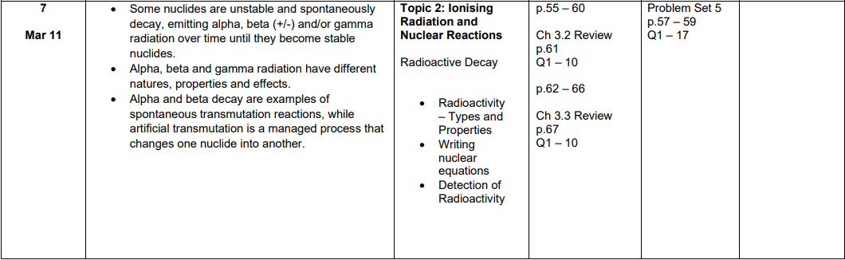

Slide 3
Learning Intentions
Describe each type of nuclear radiation in terms of penetrating and ionising abilities
Describe how a nucleus maintains stability or becomes unstable using the strong nuclear force, number of protons/neutrons
Utilise the process of radioactive decay and half-life to perform calculations

Slide 4
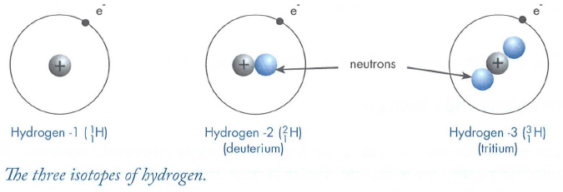
Isotopes
Different forms of an element may have a different mass number (A). These different forms of the element are called isotopes.
Isotopes of a particular element are chemically similar since they have the same number of electrons.
This makes them difficult to separate, particularly as they only differ slightly in mass and density.

Slide 5
Radioactive decay
Many nuclei, particularly those of larger atoms, are unstable and break down into simpler nuclei.
These are called radioactive isotopes, or simply radioisotopes.
During this process of radioactive decay, three different forms of nuclear radiation may be released - alpha (α), beta (β) and gamma (γ) radiation.

Slide 6
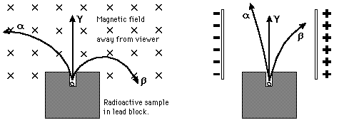
Alpha, Beta & Gamma
Historically, the products of radioactivity were called alpha, beta, and gamma when it was found that they could be analysed into three distinct species by either a magnetic field or an electric field.

Slide 7
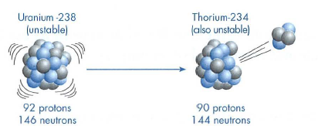

Alpha particle decay
Alpha particles consist of 2 protons and 2 neutrons, and are emitted from the nuclei of unstable atoms at up to 0.1 the speed of light. An example of alpha radiation is in the decay of uranium-238. In this process the uranium changes to a new element, thorium-234.
Note that in this decay equation the mass numbers balance (238 = 234 + 4) and the atomic numbers balance (92 = 90 + 2).

Slide 8

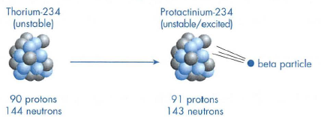
Beta particle decay
Thorium-234 is itself unstable and emits β- particles from its nucleus. A β⁻ particle is a nuclear electron travelling at up to 0.9 the speed of light. It appears that a neutron from the nucleus changes to a proton by emitting a high energy electron, called a beta particle (β⁻ ).
The overall decay equation for thorium-234 is then:

Slide 9

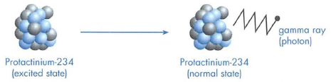
Gamma ray decay
When a nuclide undergoes either alpha or beta decay it is often left in an unstable energy state. If so, the protons and neutrons immediately rearranged in a more stable manner, and emit a quantum of energy called a photon. These photons have no mass or charge and therefore there is no change in the value of Z or A.
The photons of energy emitted are high energy, high frequency radiation. They are referred to as gamma rays (γ).The emission of γ radiation from protactinium-234 can be represented as follows:

Slide 10
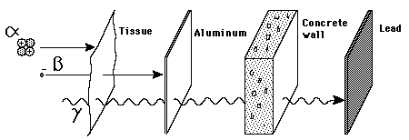
Penetration of Matter
Though the most massive and most energetic of radioactive emissions, the alpha particle is the shortest in range because of its strong interaction with matter. The electromagnetic gamma ray is extremely penetrating, even penetrating considerable thicknesses of concrete. The electron of beta radioactivity strongly interacts with matter and has a short range.

Slide 11
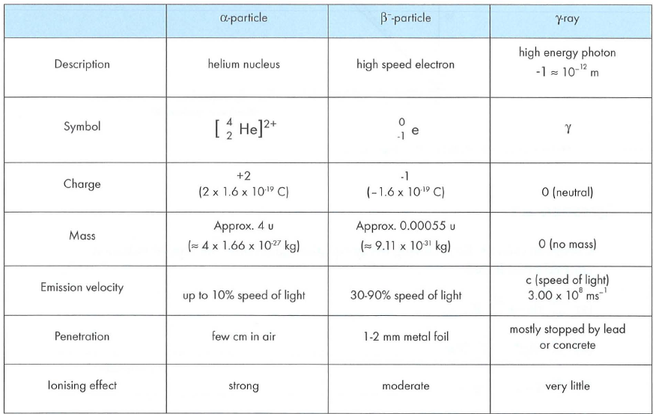
Radiation types and properties

Slide 12
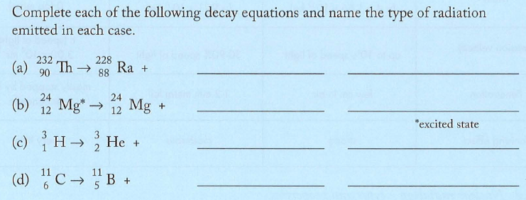
Question 2.1

Slide 13
Detecting Radiation
Radioactivity can be detected in a variety of ways, the most common being the use of a Geiger
counter.
It can also be detected by using photographic emulsions, electroscopes, cloud chambers
or solid state detectors.
In most cases this detection is made possible by the fact that α, β and γ radiation have an ionising effect.

Slide 14
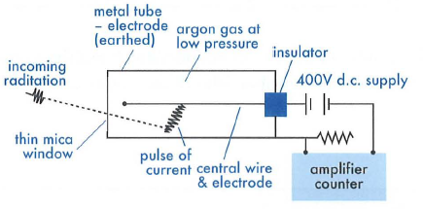
The Geiger Counter
The radiation ionises the gaseous atoms and causes a temporary pulse of current between the central wire and the metal tube. This pulse is amplified and a click is heard through the loudspeaker. The counter records the number of pulses or counts per second.
Notes:
This consists of a Geiger-Muller tube operated at high voltage and connected to
an amplifier and counter. The mica window is sufficiently thin as to allow alpha
particles as well as βετα and γαμμα radiation to enter the tube.

Slide 15
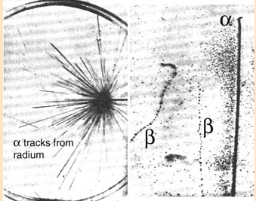
The Cloud Chamber
This device allows the tracks of charged particles to be seen.
The container is filled with super-cooled alcohol vapour. As ionising particles pass through the vapour they leave behind a trail of ionised atoms around which liquid droplets form.
The result is a vapour trail not unlike that left by high flying aircraft.
Notes:
The nature of the tracks produced in a cloud chamber is unique to each type of radiation. Alpha particle
tracks are relatively thick as they are strongly ionising. Beta-particle tracks are thin and
not straight like those of the alpha particles. Since beta particles are light they are easily pushed
off course by nearby air molecules. Gamma radiation produces tracks in an indirect way. Electrons
which absorb energy from the gamma rays escape from their atoms and leave behind a beta-like
trail

Slide 16
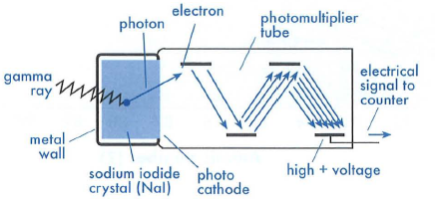
The Scintillation Counter
Consists of a solid NaI crystal with which the γ radiation interacts. Photons produced from this interaction produce electrons from a photo cathode which enter a photomultiplier tube. The electrical pulse produced can be analysed to determine both the number and energies of the γ rays.
Notes:
This is a particularly useful device for detecting and analysing gamma radiation.
Normally it is difficult to detect gamma radiation as it is very penetrating. Using a Geiger counter
for example, a gamma ray can pass right through its gas filled Geiger-Muller tube without registering
a count.

Slide 17

Dosimeters
Used to monitor personal exposure to radiation. This is particularly important for workers in areas that may be exposed to ionising radiation. Film badges or the thermoluminescent dosimeter (TLD) are commonly used.
The film badges contain photographic film in a light tight plastic holder. The degree of blackening of the film is an indication of the radiation dose received by the wearer.
The more modern radiation badges contain thermoluminescent materials. When these are exposed to radiation they store a small fraction of the energy. When heated at a later date, the TLD will emit an amount of light which is in proportion to the radiation exposure.
Notes:
This is a particularly useful device for detecting and analysing gamma radiation.
Normally it is difficult to detect gamma radiation as it is very penetrating. Using a Geiger counter
for example, a gamma ray can pass right through its gas filled Geiger-Muller tube without registering
a count.

Slide 18
Decay Series
When an unstable nuclide decays (parent nucleus) the remaining nuclide (daughter nucleus) is also
very often unstable.
The radioactive daughter product will also decay to a granddaughter nucleus.
The process continues until a stable nuclei such as lead-206 is formed.
A particular set of decays is referred to as a decay series or radioactive series.

Slide 19
Uranium − 238 Decay Series
An important naturally occurring radioactive series is that which begins with U-238 and finishes with Pb-206.
This series begins with the alpha emission from U-238 which produces Th-234. The early part of this series is as follows.

Slide 20
Uranium − 238 Decay Series
An alpha decay causes the atomic number to be reduced by 2 and the mass number by 4. A β⁻ decay actually causes an increase in atomic number. The decay series can be indicated graphically as shown on the next screen.

Slide 21
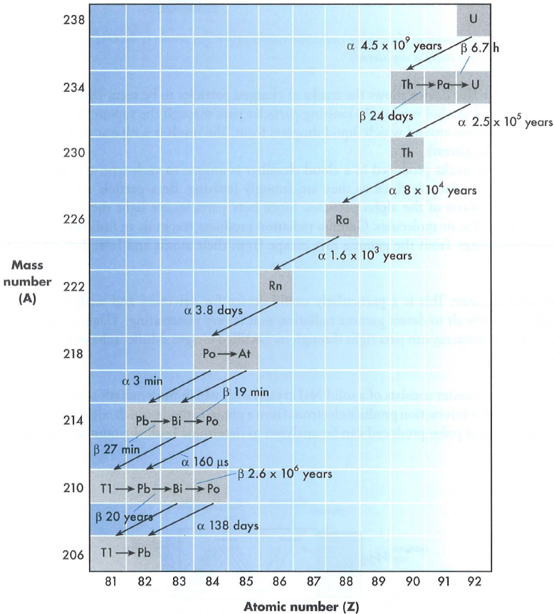

Slide 22
Success Criteria
Can you describe the 3 types of nuclear radiation in terms of their penetrating and ionising ability and suggests reasons behind the differences?
Can you describe how nuclei can become unstable in terms of the strong nuclear force, number of protons and number of neutrons?
Can you define half-life and perform the relevant calculations including using logarithms?
Can you correctly balance nuclear equations and predict possible products?

Slide 23


Student Feedback
What I learnt today…..
What I need to revise….
Images by clipart

